Slide 1
Time Series Modeling for Predictive Maintenance
Samuel Scovronski
April. 7th, 2022

Slide 2
Problem Statement
Companies and Customers want to minimize the cost of ownership while maximizing the life of their products
Current method to address those needs is a prescribed preventive maintenance schedule which results in an unoptimized solution
If scheduled too frequently then the cost of ownership is not minimized
If scheduled too infrequently then a failure could occur resulting in a lower product life
Can we reliably predict when a failure will occur with sufficient time for intervention?

Slide 3


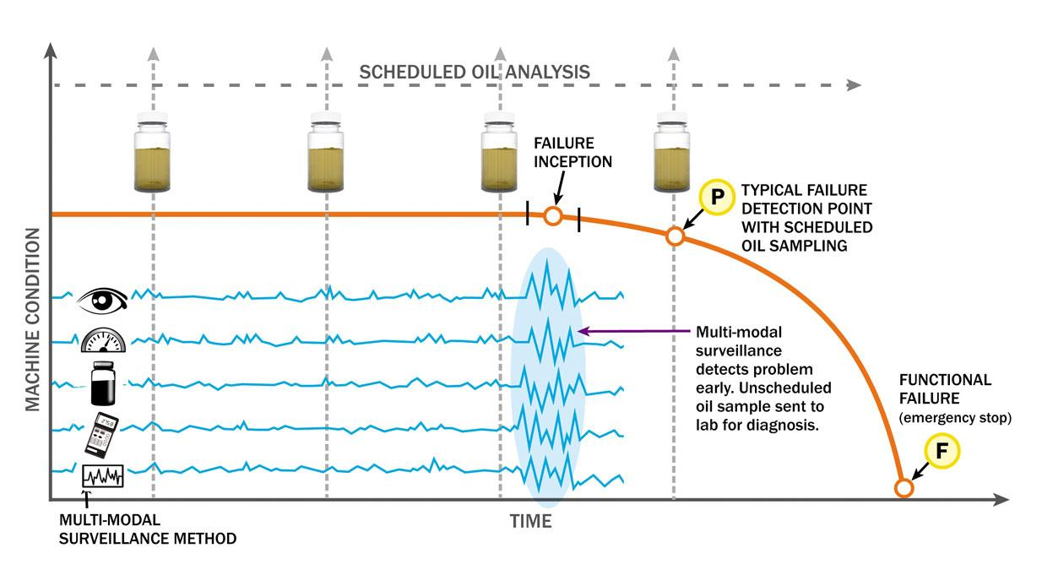
Why is it important?
Minimize unplanned downtime
Minimize maintenance costs
Sell replacements before failure

Slide 4
Data Source

Slide 5
Data Exploration

